Slide 1
Phil Bayliss, University of bristol, GSoE March, 2015
Towards a relational ethics of encounter in inclusive research contexts.

Slide 2
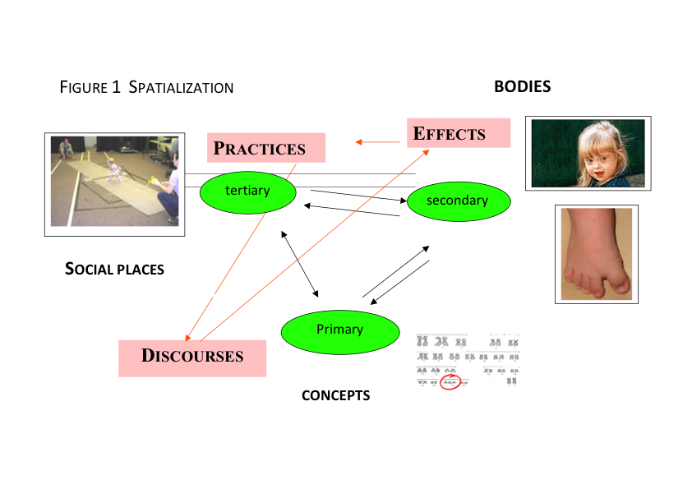
Foucault: Birth of the Clinic (1973)

Slide 3
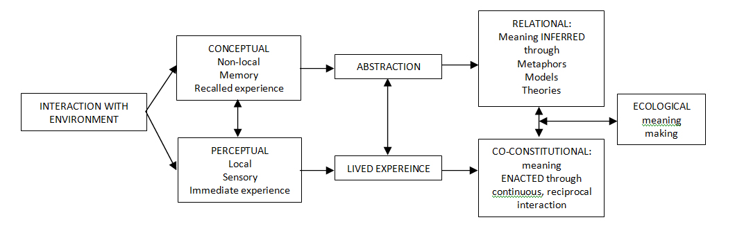
An ecological framework for learning and research (Bayliss and Dillon, 2010)

